Slide 1
LOCATION NAME HERE

Slide 2
62 LOCATIONS. 26 COUNTRIES. 6 CONTINENTS.

Slide 3
WORLD IA DAY IS SUPPORTED BY
We work to make the world’s information clearer
and easier to use by improving how people learn,
practice, and teach information architecture.
Become a member today at iainstitute.org/join

Slide 4
MEMBERS, DON’T FORGET TO VOTE!
Director of
Education
Our public face in the academic world. They work with the president on student outreach programs, the strategic future of the IA Library and the role of content in the organization.
Director of
Operations
Manages ongoing publishing, architecture and experience for all IAI online properties (iainstitute.org, worldiaday.org and the IA Conference website).
Director of
Programming
Charged with coordination and production of IAI ongoing programming (seminars, webinars, training, networking activities) .

Slide 5
Voting begins: February 23 (8AM PST)
Voting ends: March 13 (8PM PST).
(new board announced: March 20)
www.iainstitute.org/election-nominations

Slide 6
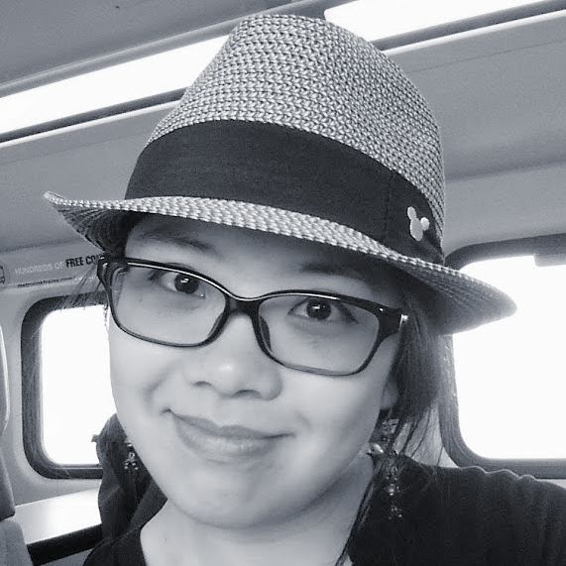

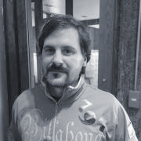
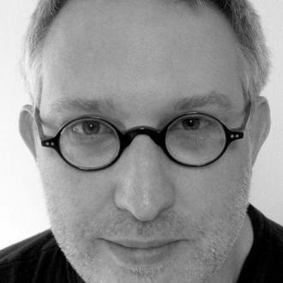
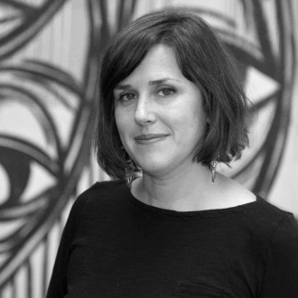
WIAD GLOBAL LEADERSHIP TEAM
GRACE LAU
Executive Producer
CATHERINE FLOURNOY
Social Media Director
EUGENIO MONFORTE
Regional Director,
Latin America
BRAM WESSEL
Sponsorship Director
AMY ESPINOSA
IAI Treasurer

Slide 7
WE ARE COMMITTED TO YOUR SAFETY
The Board of Directors of the Information Architecture Institute have drafted a code of conduct to be agreed to and upheld by any member of the global and local volunteer teams. This code of conduct applies to all volunteers, all locations, all attendees, and all speakers of World IA Day.
We do not tolerate harassment of participants, speakers or volunteers in any form.
WE ARE LISTENING: SAFETY@WORLDIADAY.ORG
worldiaday.org/code-of-conduct

Slide 8


Slide 9
[ location welcome slides… ]

Slide 10
[ some other slides you
might find useful… ]

Slide 11
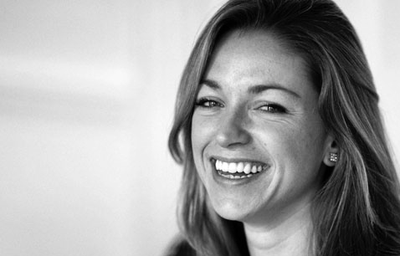
THANKS TO OUR LOCAL VOLUNTEER TEAM
ADD YOUR TEAM…
NAME
Title
NAME
Title
NAME
Title
NAME
Title
NAME
Title
NAME
Title

Slide 12
THANKS TO OUR LOCAL SPONSORS

Slide 13










THANKS TO OUR GLOBAL SPONSORS

Slide 14
GREAT GIVEAWAYS FOR ALL ATTENDEES AT
bit.ly/wiad19-swag
20% off any order!
Receive 20% off any purchase from Rosenfeld Media through our exclusive offer code.
60-day full featured licenses!
With this 60-day full license you can create fully-interactive high-fidelity prototypes that look exactly like your app should. No coding required.
30-day full access
With this 30-day full license, you can run both moderated and unmoderated studies on live websites and prototypes, record video, audio, heatmaps, clickstreams, survey questions and more

Slide 15

CONFERENCE DISCOUNTS
bit.ly/wiad19-swag
$50 Off Conference Registration
IA Summit takes place 13–17 March 2019 in Orlando, Florida, USA. The IA Summit is the preeminent professional conference on how to create and manage information spaces.
$50 Off Conference Registration
The EuroIA Summit takes place 26-28 Sep 2019 in Riga, Latvia. The EuroIA summit is Europe’s leading Information IA and UX conference.

Slide 16
GLOBAL PRIZES
bit.ly/wiad19-swag
65 lucky winners receives one free month to the Optimal Workshop
Optimal Workshop is a user research platform that helps you and your team make design decisions with confidence. Features include:
Tree Testing - Test the information architecture, labeling and design of your website or intranet
Card Sorting - Get robust card sort results with both remote testing and moderated research
Surveys - Slice and dice your results by looking into segments implied by answers to any discrete question
Five lucky winners will receive an annual subscription for Loop11.
Loop11 is the leading UX testing tool for running both moderated and unmoderated studies on live websites and prototypes. Features include:
Record video and audio,
Heatmaps
Clickstreams,
Survey questions and more.

Slide 17
LOCAL PRIZES
$100 off - One per location
One lucky winner receives US $100 off their Rosenfeld Media purchase
Free Axure License - One per location
One lucky winner will receive a free license for Axure.
Free proto.io 1-year freelancer plan - One per location
One lucky winner will receive a free 1-year freelancer plan for proto.io.

Slide 18
OFFICIAL HASHTAG:
#WIAD19
#DesignForDifference

Slide 19
WIFI INFO
ENTER CREDENTIALS HERE

Slide 20
TODAY’S AGENDA
XX:XX AM - XX:XX AM OPENING REMARKS BY ORGANIZER NAME
XX:XX AM - XX:XX AM SESSION 1 BY SPEAKER NAME
XX:XX AM - XX:XX AM SESSION 2 BY SPEAKER NAME
XX:XX AM - XX:XX AM SESSION 3 BY SPEAKER NAME

Slide 21
[ closing slides… ]

Slide 22
SEE YOU NEXT YEAR!
February 22, 2020

